Slide 1
Electrical
and Electronics science
First year
Computer Science and Engineering
Dr. Shakti Singh
ASSISTANT PROFESSOR
ELECTRCIAL AND INSTRUMENATION
ENGINEERING DEPARTMENT
@shakti.singh@thapar.edu

Slide 2
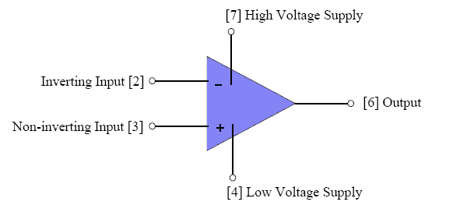
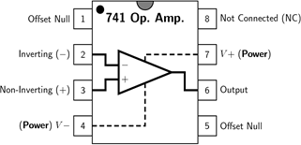
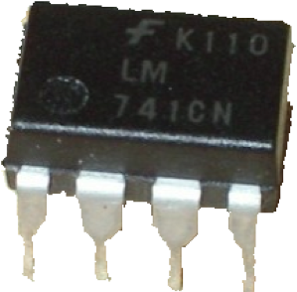
Introduction
An Op Amp is an IC packaged into a single case to form a functional circuit.
Op Amp were primarily used to perform mathematical operations such as addition, subtraction, integration and differentiation, thus the term operational.

Slide 3
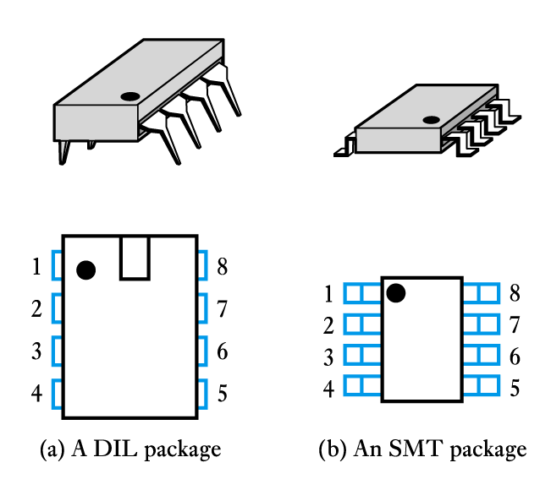
Introduction
Operational amplifiers (op-amps) are among the most widely used building blocks in electronics
they are integrated circuits (ICs)
often DIL or SMT

Slide 4
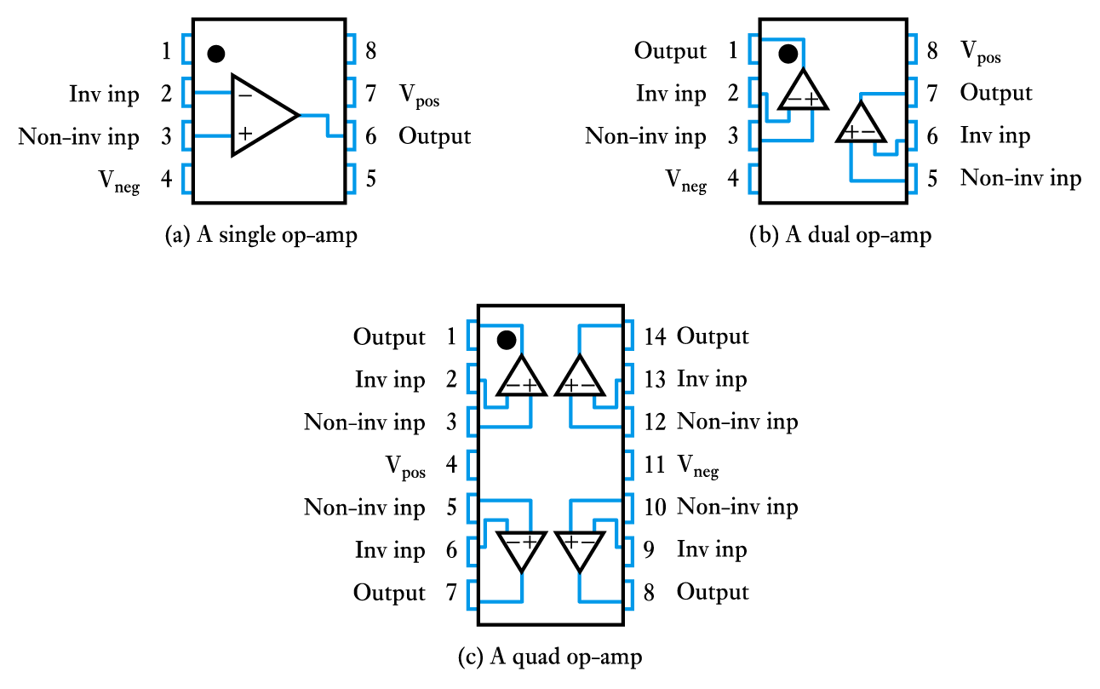
A single package will often contain several op-amps

Slide 5
Background
Originally invented in early 1940s using vacuum tube technology
Initial purpose was to execute math operations in analog electronic calculating machines
Shrunk in size with invention of transistor
Most now made on integrated circuit (IC)
Only most demanding applications use discrete components
Huge variety of applications, low cost, and ease of mass production make them extremely popular

Slide 6
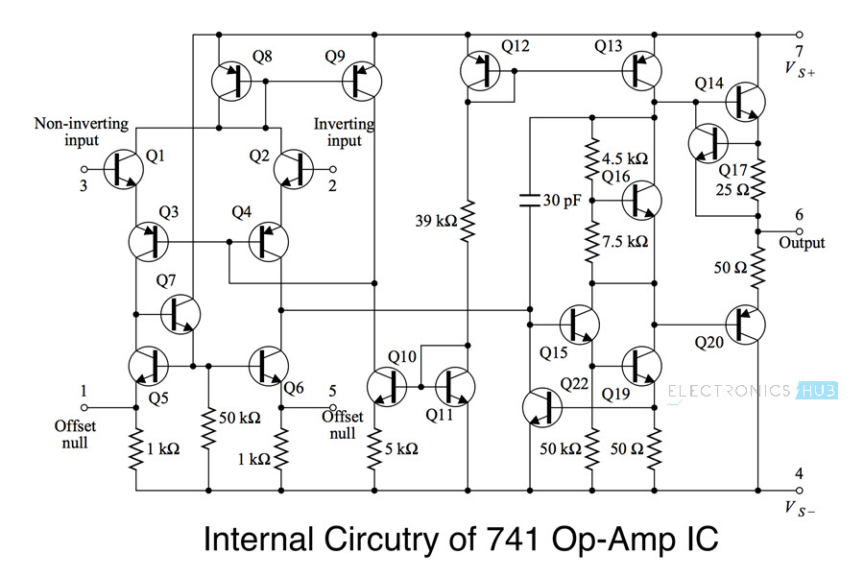
Introduction
The internal structure of OpAmp is much more complex and consists of 20 transistors along with biasing resistors and capacitors.

Slide 7
Operational Amplifier
Output gain high
A ~= 10⁶
Tiny difference in the input voltages result in a very large output voltage
Output limited by supply voltages
Comparator
If V₊>V₋, V_{out} = HVS
If V₊<V₋, V_{out} = LVS
If V₊=V₋, V_{out} = 0V

Slide 8
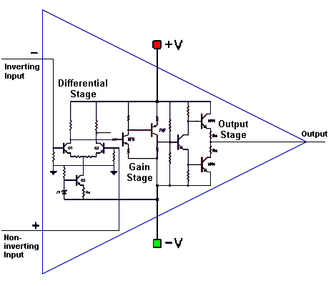
3-stage Op-Amp

Slide 9
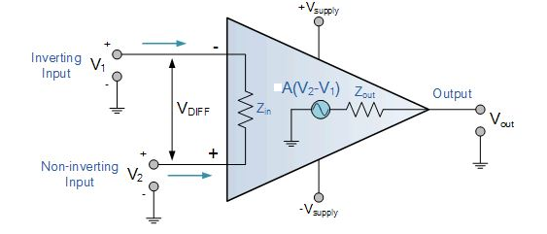
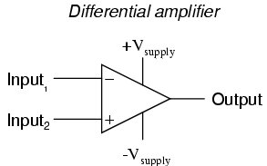
Equivalent Circuit
Differential Amplifier
Amplifies difference between inputs
The amplifier’s differential inputs consist of a non-inverting input with voltage (V+) and an inverting input with voltage (V−). Ideally, an op-amp amplifies only the difference in voltage between the two, also called differential input voltage. The output voltage of the op-amp V_{out} is given by the equation:
V_{out} = A_{OL} (V₊ – V–)

Slide 10
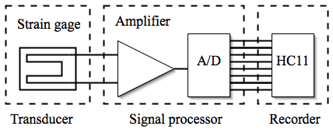
Why are they useful?
Sensor signals are often too weak or too noisy
Op Amps ideally increase the signal amplitude without affecting its other properties

Slide 11
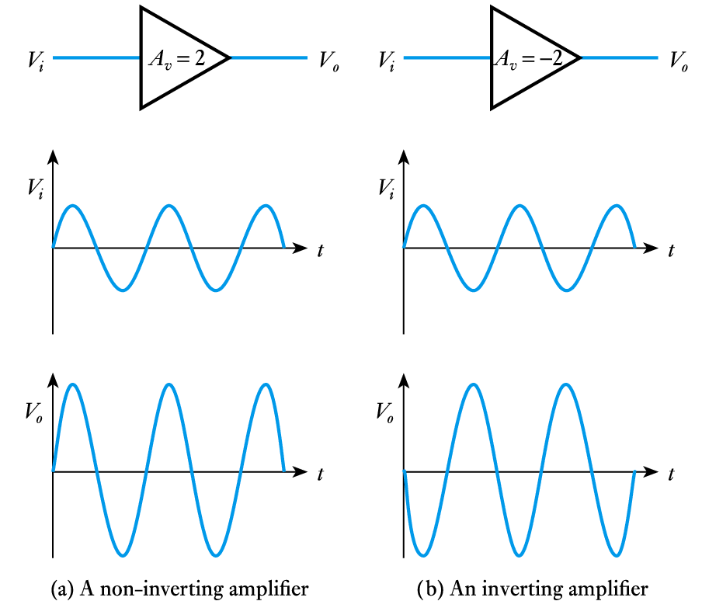
Basic Operational Amplifier Circuits
Inverting and non-inverting amplifiers

Slide 12
CHARACTERISTICS OF AN IDEAL OP- AMP
Infinite voltage gain A
Infinite input resistance Z_{in}
Zero output resistance Z_{out}
Zero output voltage when input voltage is zero
Infinite bandwidth
Infinite common mode rejection ratio so that the output common mode noise voltage is zero

Slide 13

Ideal Op Amp vs Practical Opamp
Parameters | Ideal Op-Amp | Typical Op-Amp
Input Resistance | infinity | 10⁶ Ω (bipolar) 10⁹ Ω - 10¹² Ω (FET)
Input Current | 0 | 10⁻¹² – 10⁻⁸ A
Output Resistance | 0 | 100 – 1000 Ω
Operational Gain | infinity | 10⁵ - 10⁹
Common Mode Gain | 0 | 10⁻⁵
Bandwidth | infinity | Attenuates and phases at high frequencies (depends on slew rate)
Temperature | independent | Bandwidth and gain

